Slide 1
Intercollegiate MRCS
Part A Pearson Vue Familiarisation Webinar

Slide 2
Overview
Why Pearson Vue?
How to book your test centre
Changing your test centre
On the day of the exam
Questions

Slide 3
Why Pearson Vue
Retains the advantages of online delivery
Same experience for all candidates
Local exam centre - 5,000 worldwide
Used for FRCS and other Royal Colleges

Slide 4
Booking your exam

Slide 5
Booking timeline
1 April 2022
10 April 2022
10 May 2022
Pearson Vue registration email
Pearson Vue test centre scheduling email
10 days
Exam Schedule Window closes
No changes allowed
Exam
day

Slide 6
Booking your test centre
Receive email from Pearson Vue on 1 April to set up your account
Receive a second email saying you are authorised to book your seat (this will include a link to book your seat)
10 days to book your seat at your nearest test centre
You must book by 10 April or else you will not be able to sit and no refund will be permitted
Seats are assigned on a first-come-first served basis
Reasonable adjustments will be displayed if you have requested them
You will receive an email confirming your booking

Slide 7
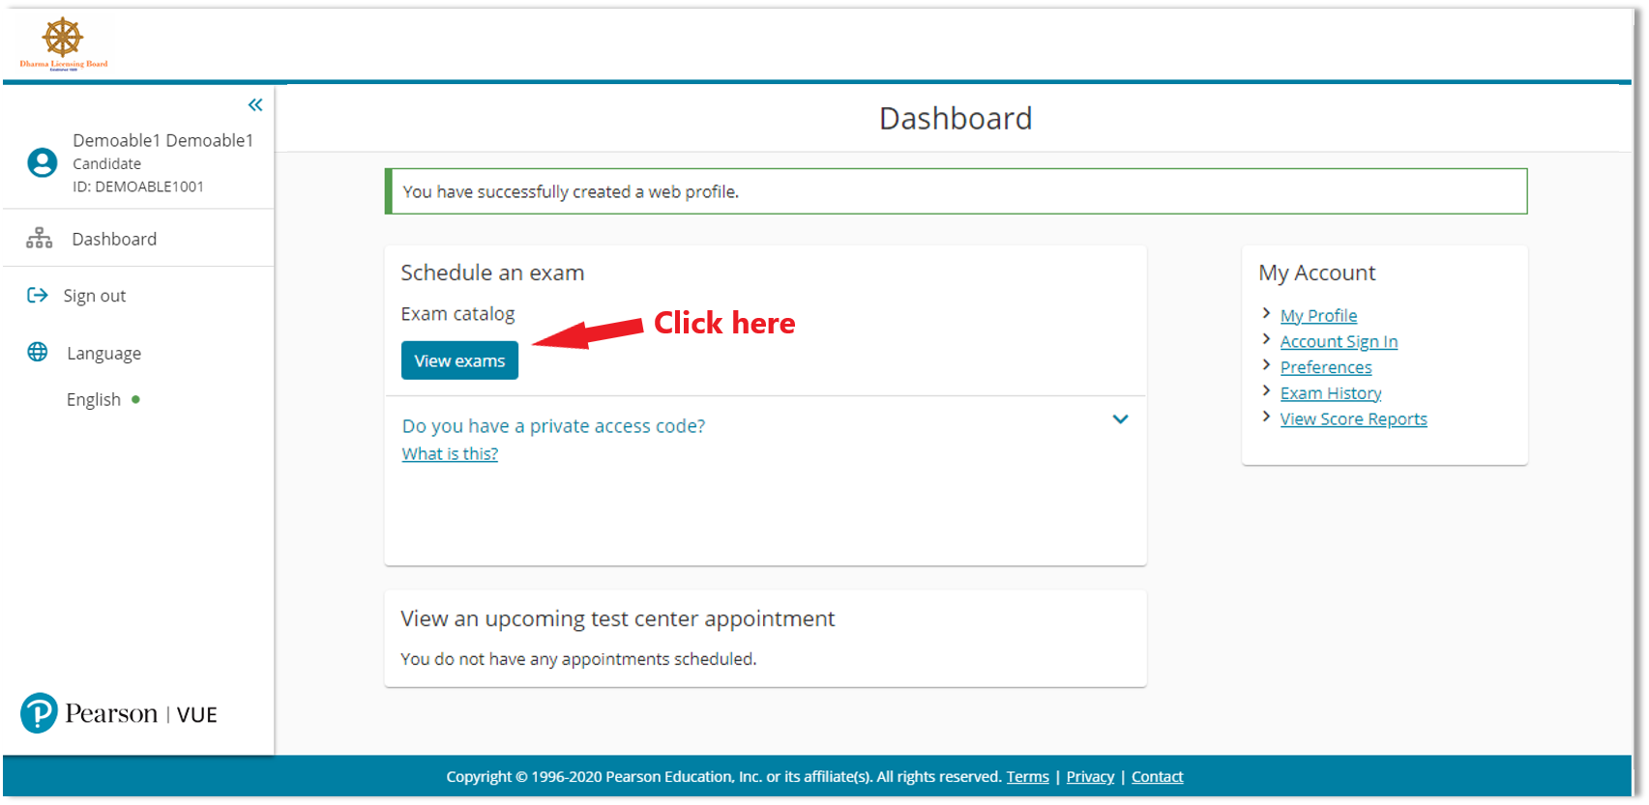
The booking website

Slide 8
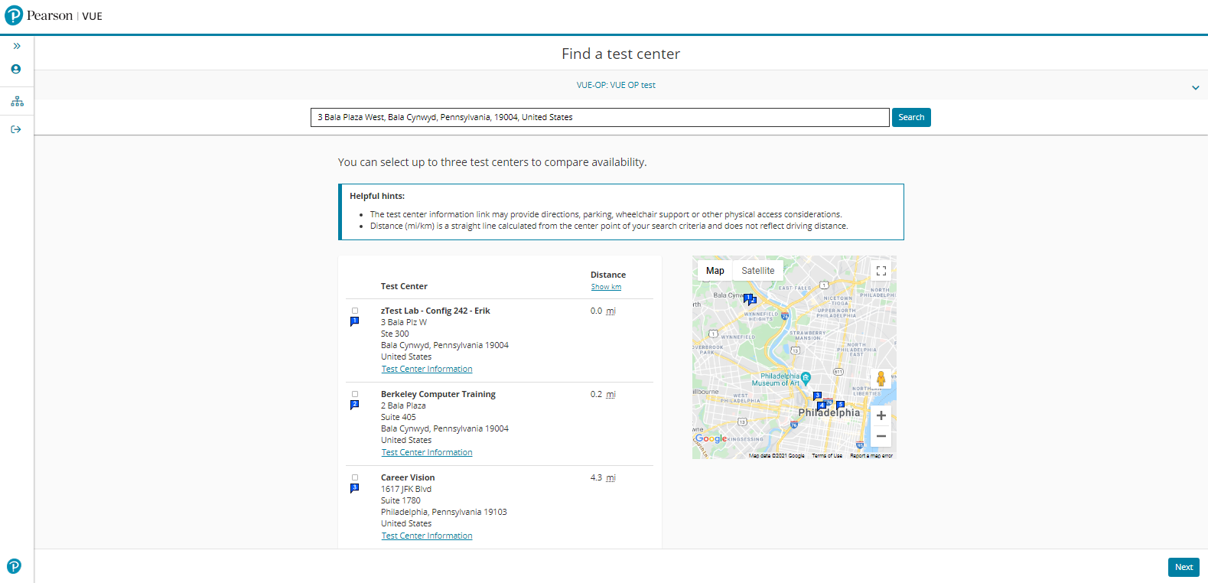
The booking website
Once you have selected MRCS Part A, you will be shown your nearest centres based on the address you gave when you applied.
You can search for other centres near to you using the search bar at the top.

Slide 9
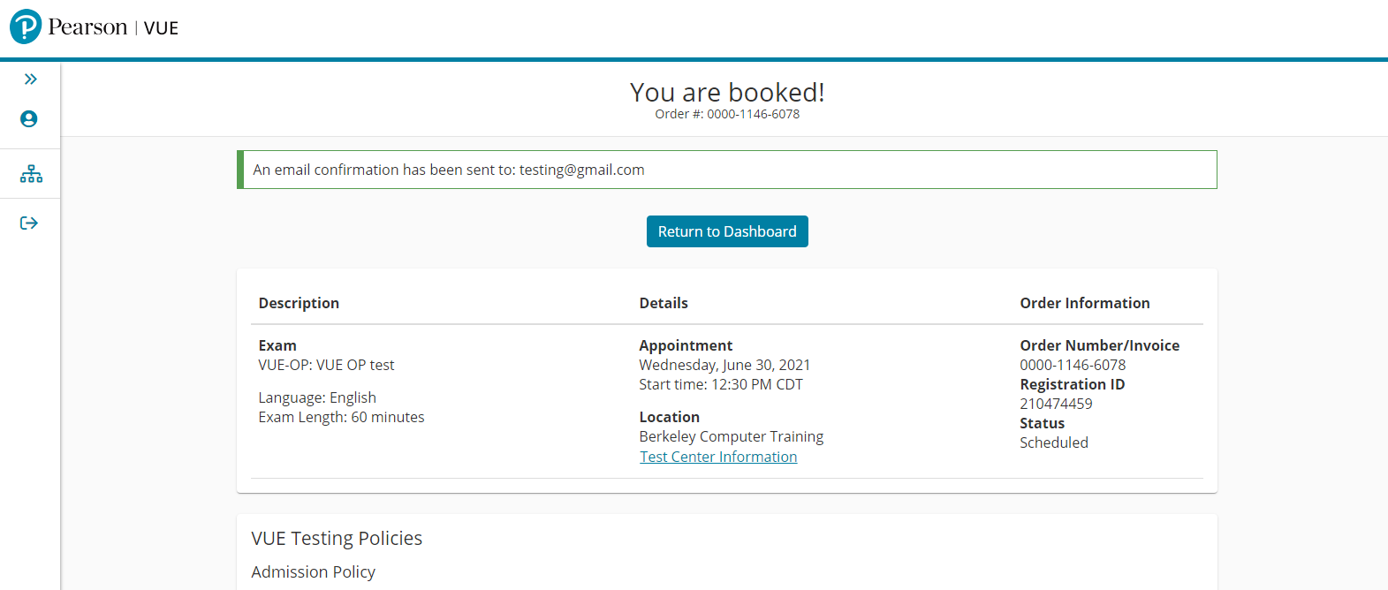
The booking website
Once you have booked, you will receive a message confirming you have booked. A copy of this message will also be emailed to you.

Slide 10
If you have trouble booking
Contact Pearson Vue via the website or phone
Colleges are unable to access the PV system and will not be able to help
Only contact your College if you have not received a booking email by the end of the day on 1st April

Slide 11
Rescheduling your exam

Slide 12
‘Rescheduling’
Rescheduling means changing the location of your test centre
There are no options to change the date or time
You can change your test centre (‘reschedule’) at any point during the 10-day schedule window
You cannot change your test centre after the booking window has closed on 10 April
Bookings with reasonable adjustments can only be changed via phone

Slide 13
On the day of the exam

Slide 14
On the day
Arrive at your centre 30 minutes before your exam start time
If you arrive more than 15 minutes late, you will not be able to sit
Complete a number of security and admissions checks

Slide 15
Security checks
Read and agree to testing rules
Complete ID checks
All belongings must be stored in a locker – including phones, tablets, books, watches
Invigilator will check you for belongings before you enter the testing room – including behind your ears, pocket check and glasses check
Escorted to your booth which is equipped with video and audio recording

Slide 16
The exam itself
Applied Basic Sciences (ABS) paper – 3 hours
1 hour break
You can leave the test room / centre
You must complete ID checks again to re-enter
Principles of Surgery in General (PoSG) paper – 2 hours
You may leave when you have finished
No results available on the day

Slide 17
Breaks and accommodations
If you need to take an unscheduled break to use the bathroom, time will keep running. You may be required to show your ID again to re-enter.
Pearson Vue will have been informed of any accommodations (reasonable adjustments) you have requested, including extra time. Reasonable adjustment requests would have been approved by your College during the examination booking and communicated to Pearson Vue.

Slide 18
The exam itself
Exam completed at a computer using only a mouse
You will be given an erasable whiteboard and pen to do any calculations
No calculators allowed
There will be a short tutorial before the exam begins – this is not counted as part of your testing time
Questions are randomised for all candidates

Slide 19
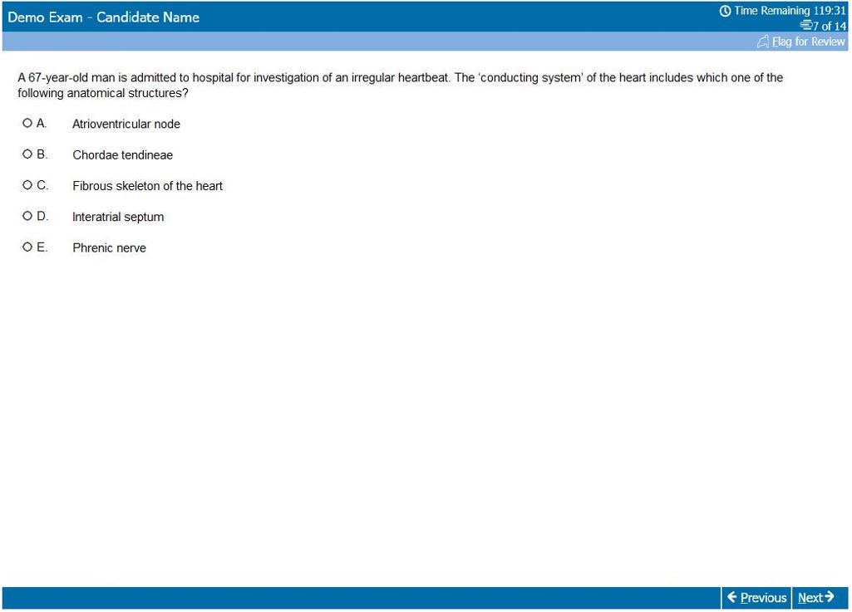
The exam screen
Time remaining
Question number (of total)
Review flag
Question
Question navigation

Slide 20
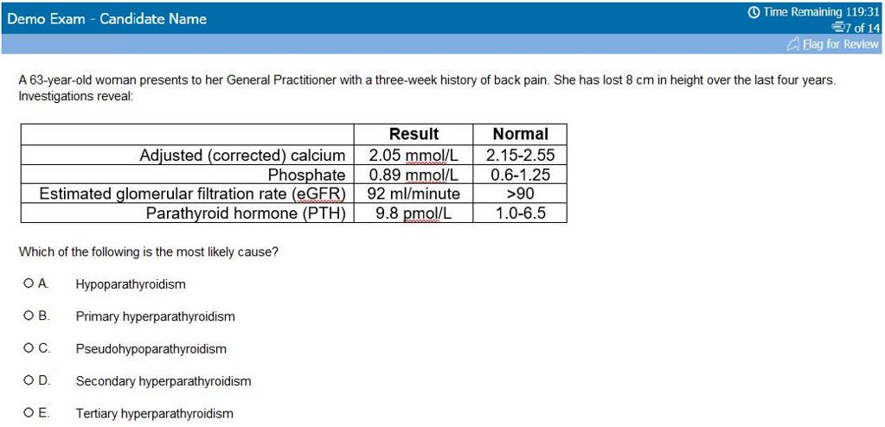
The exam screen
Question

Slide 21
Common Questions

Slide 22
Common questions
Can I see a list of my nearest PV centres ahead of the test centre schedule window?
Pearson Vue cannot provide this – each list is unique to each exam provider and the exact capacity of each centre is being finalised up to the opening of the schedule window. Candidate location details have been provided to Pearson Vue and these are taken into account when planning which centres are available.
Can I cancel my exam after the 10-day schedule window?
If you cancel your exam after the 10-day window, you will need to contact both the College to whom you applied and Pearson Vue. You will not be able to reschedule after the 10-day window. If you cancel, you will not be able to sit the exam and you will not receive a refund of your exam fee as per ICBSE reulations.

Slide 23
Common questions
What happens if I miss the 10-day schedule window?
If you fail to log in and book during the 10-day window, you will not be able to sit, and you will forfeit your exam fee.
What happens if I don’t turn up?
If you don’t turn up to your exam, you will again forfeit your exam fee as per ICBSE regulations.

